Slide 1


Big Data Analytics - 23326 F300 A - Spring 23

Slide 2
Group 8 Project Presentation
Vinay Kumar Camarushi (700740428)
Navya Bandla (700745181))
Sriya Gudipudi (700742084)
Mahidhar Sai Mortha (700740440)

Slide 3
Matrix Multiplication
- A Map Reduce Application

Slide 4
Introduction
The matrix multiplication is the dominant of many business applications such as calculate profits based on price and quantity matrices, predict various weather phenomena following the study of Markov Chains, create Similarities table in a recommendation system and so forth.
Some real word problems, matrices are very large in size that is very time-consuming operation even though there are execution strategies on regular matrices and sparse matrices.
Hence a MapReduce application is used to solve the problem of multiplying matrices of larger order in lesser time efficiently.

Slide 5
Aim
Our aim is to perform large scale Matrix Multiplication using a Map Reduce application for efficient memory consumption and execution time.

Slide 6
Technical Requirements
Recommended hardware requirements for smooth processing.
8 GB of RAM or higher
Intel i5 Processor or higher
16 GB of Storage or higher
Software Requirements
A code editor (Visual Studio Code or IntelliJ)
Hadoop
Java
Dependencies of Hadoop like Maven etc.,

Slide 7
What Is Hadoop ?
Apache Hadoop is a collection of open source software utilities that facilitates using a network of many computers to solve problems involving massive amounts of data and computation. It provides a software framework for distributed storage and processing of big data using the MapReduce programming model.
The core of Apache Hadoop consists of a storage part, known as Hadoop Distributed File System (HDFS), and a processing part which is a MapReduce programming model.
Hadoop splits files into large blocks and distributes them across nodes in a cluster. It then transfers packaged code into nodes to process the data in parallel. This approach takes advantage of data locality, where nodes manipulate the data they have access to.
This allows the dataset to be processed faster and more efficiently than it would be in a more conventional supercomputer architecture that relies on a parallel file system where computation and data are distributed via high-speed networking.
https://hadoop.apache.org/

Slide 8
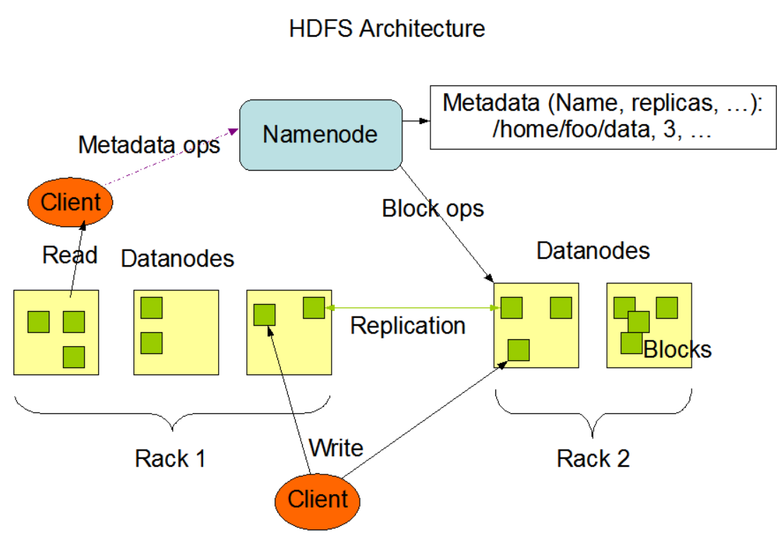
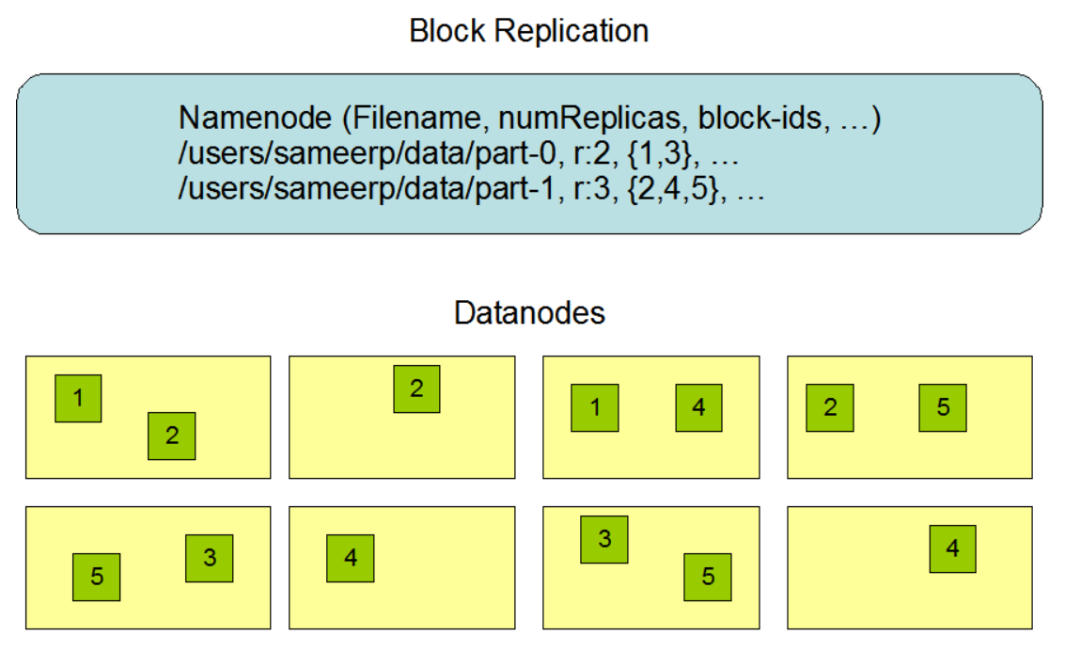
Hadoop Distributed File System (HDFS )
The Hadoop Distributed File System (HDFS) is a distributed file system designed to run on commodity hardware.
The NameNode and DataNode are pieces of software designed to run on commodity machines.
The NameNode maintains the file system namespace. Any change to the file system namespace or its properties is recorded by the NameNode.
An application can specify the number of replicas of a file that should be maintained by HDFS.
The number of copies of a file is called the replication factor of that file.
https://hadoop.apache.org/

Slide 9
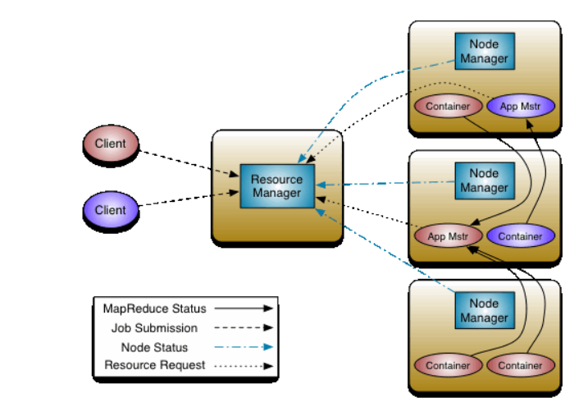
Hadoop YARN
The fundamental idea of YARN is to split up the functionalities of resource management and job scheduling/monitoring into separate daemons.
The idea is to have a global ResourceManager (RM) and per application ApplicationMaster (AM). An application is either a single job or a DAG of jobs.
The ResourceManager and the NodeManager form the data-computation framework. The ResourceManager is the ultimate authority that arbitrates resources among all the applications in the system.
The NodeManager is the per-machine framework agent who is responsible for containers, monitoring their resource usage (cpu, memory, disk, network) and reporting the same to the ResourceManager/Scheduler.
https://hadoop.apache.org/

Slide 10
Proposed Methodology
MapReduce is a technique in which a huge program is subdivided into small tasks and run parallelly to make computation faster, save time, and mostly used in distributed systems. It has 2 important parts.
Mapper takes raw data input and organizes into key, value pairs. For example, In a dictionary, you search for the word “Data” and its associated meaning is “facts and statistics collected together for reference or analysis”. Here the Key is Data and the Value associated with is facts and statistics collected together for reference or analysis.
Reducer is responsible for processing data in parallel and produce final output.
Mapper
Reducer

Slide 11
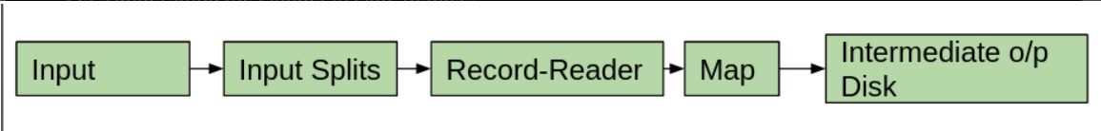
The Mapper Class
Maps input key/value pairs to a set of intermediate key/value pairs.
Maps are the individual tasks which transform input records into a intermediate records. The transformed intermediate records need not be of the same type as the input records. A given input pair may map to zero or many output pairs.
The Hadoop Map-Reduce framework spawns one map task for each InputSplit generated by the InputFormat for the job.
All intermediate values associated with a given output key are subsequently grouped by the framework, and passed to a Reducer to determine the final output.
https://www.geeksforgeeks.org/hadoop-mapper-in-mapreduce/

Slide 12
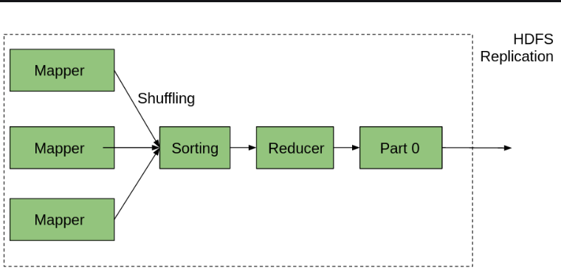
The Reducer Class
Reduces a set of intermediate values which share a key to a smaller set of values.
Reducer has 3 primary phases:
Shuffle
The Reducer copies the sorted output from each Mapper using HTTP across the network.
Sort
The framework merge sorts Reducer inputs by keys (since different Mappers may have output the same key).
The shuffle and sort phases occur simultaneously i.e. while outputs are being fetched they are merged.
The Hadoop Map-Reduce framework spawns one map task for each InputSplit generated by the InputFormat for the job.
Reduce
In this method reduce method is called for each key in the sorted inputs.
The output of the reduce tasl is typically written to a record writer.
https://www.geeksforgeeks.org/hadoop-reducer-in-mapreduce/

Slide 13
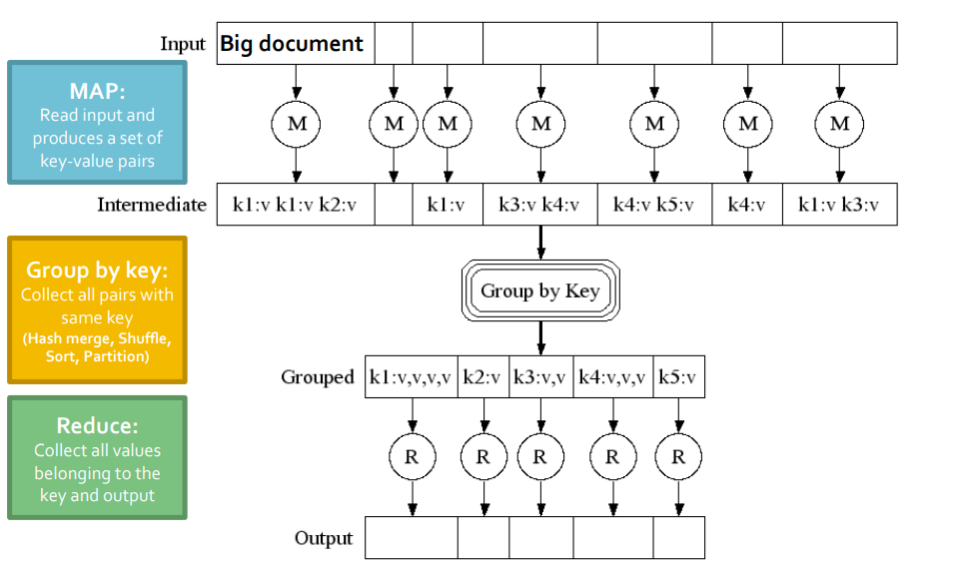
A General Overview of MAPReduce

Slide 14
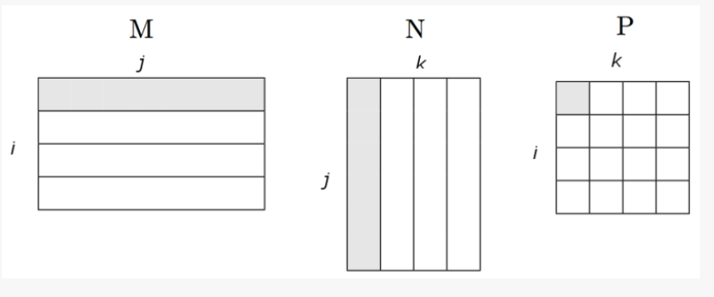
Matrix multiplication
Suppose we have a pxq matrix M, whose element in row i and column j will be denoted m_ij and a q*r matrix N whose element in row j and column k is donated by n_jk then the product P = MN will be pxr matrix P whose element in row i and column k will be donated by P_ik, where P_i,k = m_ij * n_jk.

Slide 15
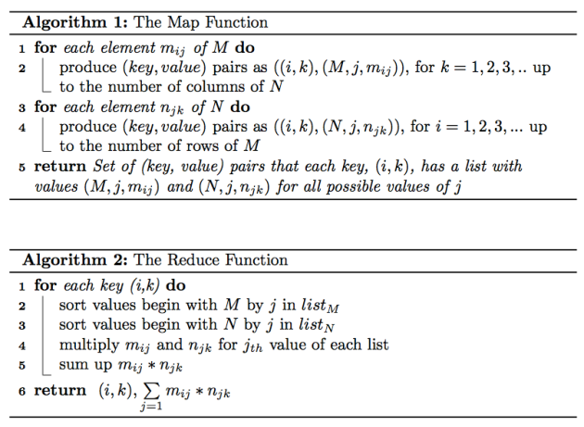
Matrix Multiplication Using MApRduce

Slide 16
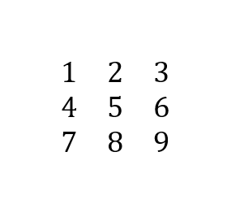
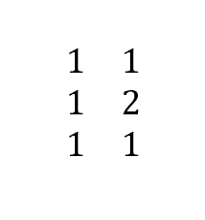
Sample Input
The input file that has the matrices has the following lines in the input text file.
A
A,0,0,1
A,0,1,2
A,0,2,3
A,1,0,4
A,1,1,5
A,1,2,6
A,2,0,7
A,2,1,8
A,2,2,9
A
B
B
B,0,0,1
B,0,1,1
B,1,0,1
B,1,1,2
B,2,0,1
B,2,1,1

Slide 17
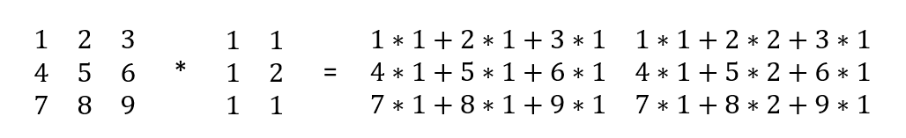
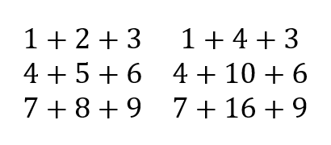
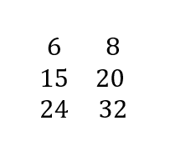
Sample output
The multiplication will take place as follows.
Step 1:
Step 2: Step 3:

Slide 18
Code for Matrix Multiplication
public static class Map extends Mapper<Object, Text, Text, Text> {
private int m;
private int p;
public void setup(Context context) {
Configuration conf = context.getConfiguration();
m = Integer.parseInt(conf.get("m"));
p = Integer.parseInt(conf.get("p")); }
@Override
public void map(Object key, Text value, Context context)
throws IOException, InterruptedException {
String line = value.toString();
String[] input = line.toString().replaceAll("\\s+", "").split(",");
String matrixName = input[0];
int i = Integer.parseInt(input[1]);
int j = Integer.parseInt(input[2]);
int matrixValue = Integer.parseInt(input[3]);
if (matrixName.equals("A")) {
for (int k = 0; k < p; k++) {
context.write(new Text(i + "," + k), new Text(matrixName + "," + j + "," + matrixValue));
}
}
else {
for (int k = 0; k < m; k++) {
context.write(new Text(k + "," + j), new Text(matrixName + "," + i + "," + matrixValue)); } } } }
The Mapper Class

Slide 19
Code for Matrix Multiplication
public static class Reduce extends Reducer<Text, Text, Text, IntWritable> {
@Override
public void reduce(Text key, Iterable<Text> values, Context context) throws IOException, InterruptedException {
String[] value;
Configuration conf = context.getConfiguration();
HashMap<Integer, Integer> hashA = new HashMap<Integer, Integer>();
HashMap<Integer, Integer> hashB = new HashMap<Integer, Integer>();
for (Text val : values) {
String line = val.toString();
value = line.toString().replaceAll("\\s+", "").split(","); if (value[0].equals("A")) {
hashA.put(Integer.parseInt(value[1]), Integer.parseInt(value[2])); }
else {
hashB.put(Integer.parseInt(value[1]), Integer.parseInt(value[2])); } }
int n = Integer.parseInt(context.getConfiguration().get("n"));
int result = 0;
for (int j = 0; j < n; j++) {
result += hashA.get(j) * hashB.get(j); }
context.write(key, new IntWritable(result));
}}
The Reducer Class

Slide 20
Code for Matrix Multiplication
public static void main(String[] args) throws Exception {
Configuration conf = new Configuration();
// M is an m-by-n matrix; N is an n-by-p matrix.
conf.set("m", args[0]);
conf.set("n", args[1]);
conf.set("p", args[2]);
@SuppressWarnings("deprecation")
Job job = new Job(conf, "matrix multiplication"); job.setJarByClass(MatrixMultiplication.class);
job.setOutputKeyClass(Text.class);
job.setOutputValueClass(Text.class);
job.setMapperClass(Map.class);
job.setReducerClass(Reduce.class);
FileInputFormat.addInputPath(job, new Path(args[3])); FileOutputFormat.setOutputPath(job, new Path(args[4])); job.waitForCompletion(true); }
The Main Class (main driver class)

Slide 21
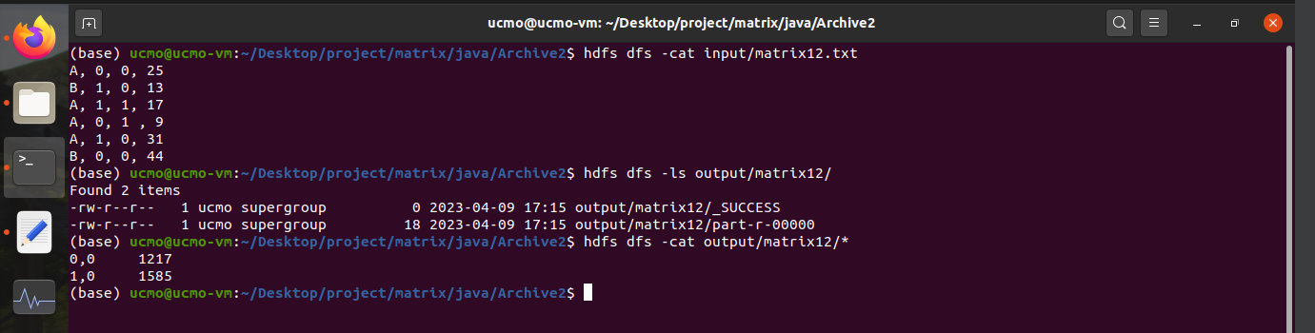
Sample Input & Output

Slide 22


Thank you

